Slide 1

PARSLFEST 2025
Accelerating QMCpy Notebook Tests with Parsl
By Joshua Herman (QMC Development Team)
Joint Work: Dr. Sou-Cheng Choi, Illinois Tech and SouLab;
Notes:
Hi I am with QMCSoftware which is a group originating from IIT but includes people in industry. This in joint work with Dr. Sou-Chenge Choi of IIT and SouLab and the QMCPy development team

Slide 2

WHO WE ARE
Hello!
15+ years of experience as a software engineer
Open source contributor to Python
Conference speaker: DEF CON, Skytalks, PyOhio
Recreational applied mathematics: QMCpy, CA
Notes:
Hi, I’m Joshua Herman, a Python-focused software engineer with 15+ years of experience. I contribute QA to QMCpy by fixing notebooks, making tests faster, track regressions, bugs and increasing coverage for— I’ve spoken on software security, IoT devices, and LLM tooling at events including DEF CON/Skytalks and PyOhio, and I also contribute to CPython. (cellular automata QMCPy)
Hi, my name is Joshua herman and I have worked on mainly QA tasks with QMCPy especially with Notebooks to track regressions and bugs. I have also given talks on software security and IoT Devices and LLM tooling. I have fourteen year of experience in software engineering in Python. Other open source projects i have contributed to are CPython. I help out with an organization called QMCSoftware

Slide 3
26 JUNE 2024
Our notebooks need to be reproducible and they are resource intensive.

Slide 4
HOW WE ARE DOING THIS
How we are using Parsl to speed up Testbook Execution
Testing is done with a testbook file corresponding to a Juypter Notebook
Runs by using a Parsl test harness
Created simple tests to evaluate Parsl
Notes:
By breaking down the tests into seperate testbook files we then load each test into a Parsl test harness and after double checking that our testbook checks pass we then compared the runtime of the serial test and the parallel tests

Slide 5
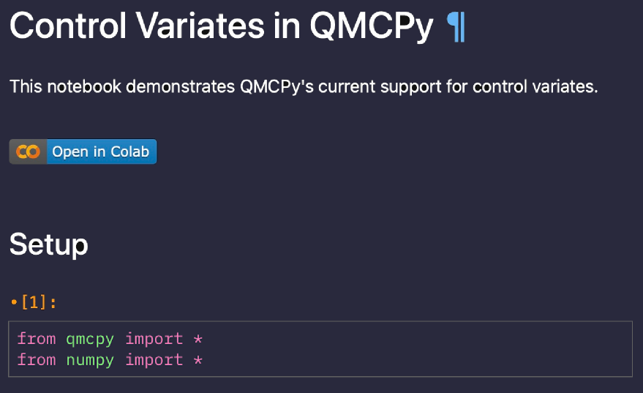
HOW WE ARE DOING THIS
Notebook Cell To Test
Notes:
This is a unit test example from testbook. What we are testing is cell 1 of the notebook where we are importing two packages in the first cell

Slide 6
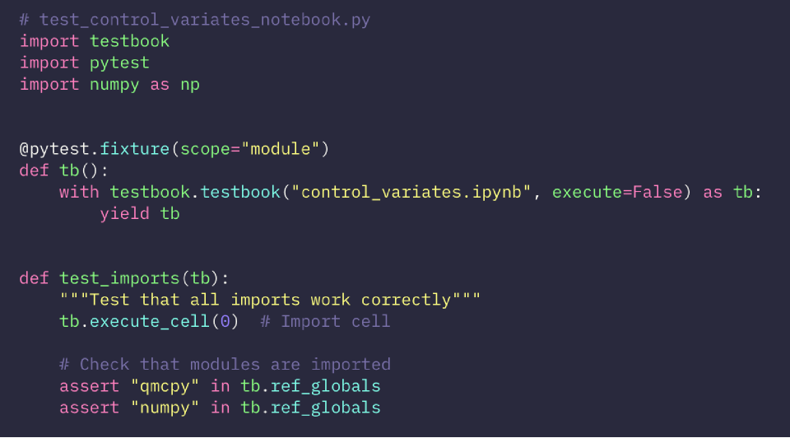
HOW WE ARE DOING THIS
Testbook Example Test
Here is the code that tests the cell we have in the previous notebook.
Notes:
How this works is that the notebook is interpreted by testbook . SHorten description don't go through everything only talk about imports delete testbook, pytest, numpy are in the juypter notebook runtime

Slide 7
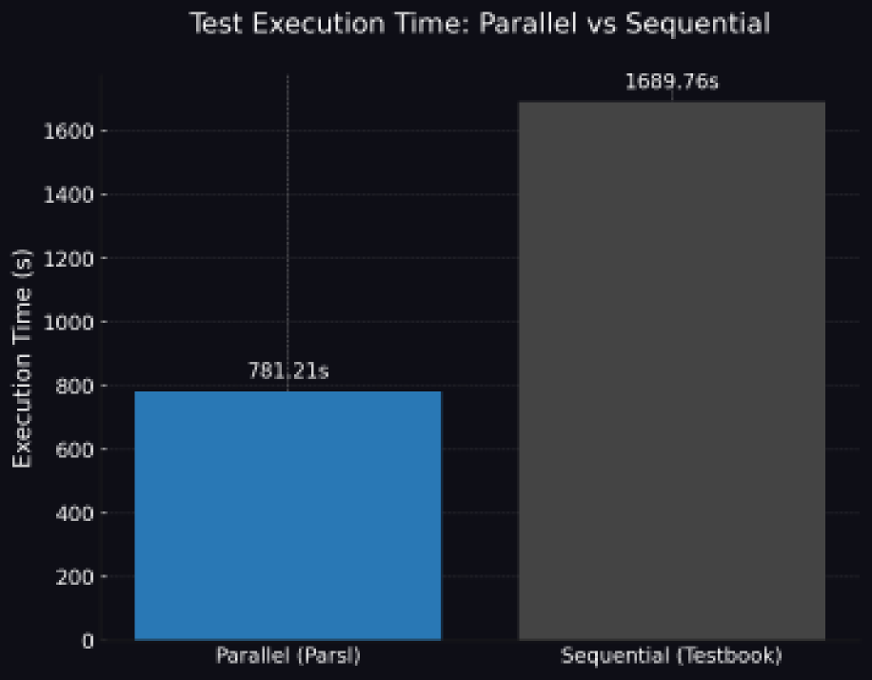
PRELIMINARY RESULTS
Test stubs
Speedup of +216%
Notes:
We were able to get a +216% speedup when run in parallel using Parsl on a 16 core machine by taking our testbook tests and writing a Parsl test runner. Making sure test runner gives us a tangible speedup.
Today, we are discussing the performance gains achieved with our new approach.
By running all twenty notebooks in parallel on a multicore machine, we achieved a significant speed increase of 2.16x.
The parallel testbook execution time was recorded at 781.21 seconds.
This represents a remarkable 216% speedup on Ubuntu with 16 cores on x86-64 architecture.
In contrast, the sequential testbook execution time was much longer at 1689.76 seconds.

Slide 8
FUTURE WORK
Implement Testbook tests for all of our notebooks
Integrate parsl with more of our tests
Use Parsl to run tests of QMCpy remotely
Notes:
Once we implement full testing using testbook using parsl for a local machine and expanding them with more of our tests it would be interesting to run QMCpy tests remotely which would also most likely allow us to run QMCpy in a large distributed manner.

Slide 9
26 JUNE 2024
zitterbewegung@gmail.com
https://qmcpy.org
https://github.com/nteract/testbook

